Slide 1
Interesting Products
Personal Items
Basic 1 – Unit 3 a

Slide 2
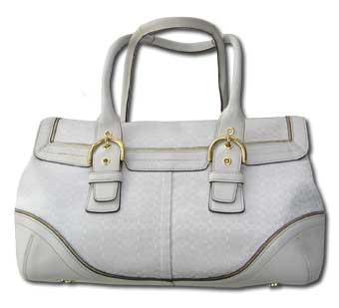
What is this?
It is a purse

Slide 3
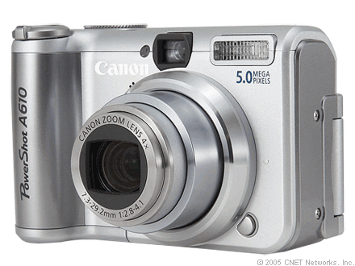
What is this?
It is a camera.

Slide 4
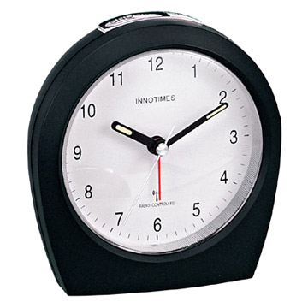
What is this?
It is a clock.

Slide 5
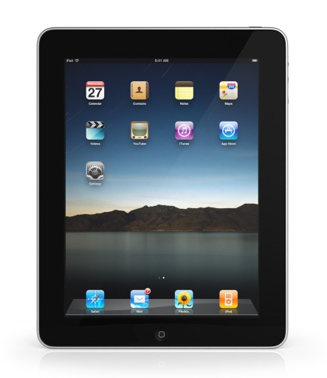
What is this?
It is an iPad

Slide 6

What is this?
It is a key.

Slide 7
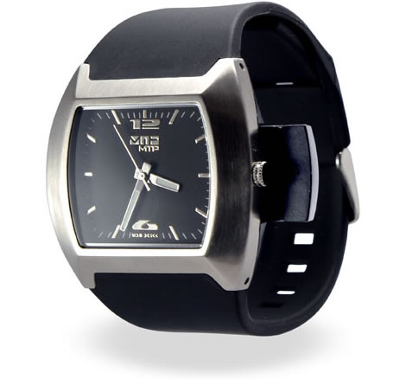
What is this?
It is a watch.

Slide 8
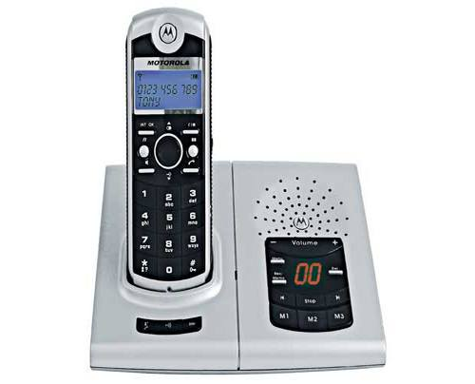
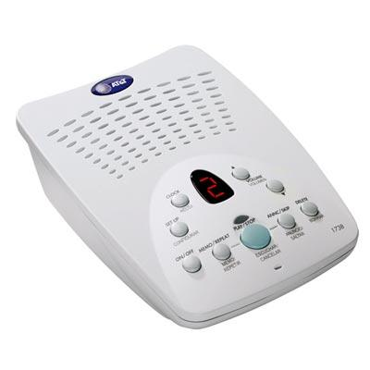
What is this?
It is an answering machine.

Slide 9
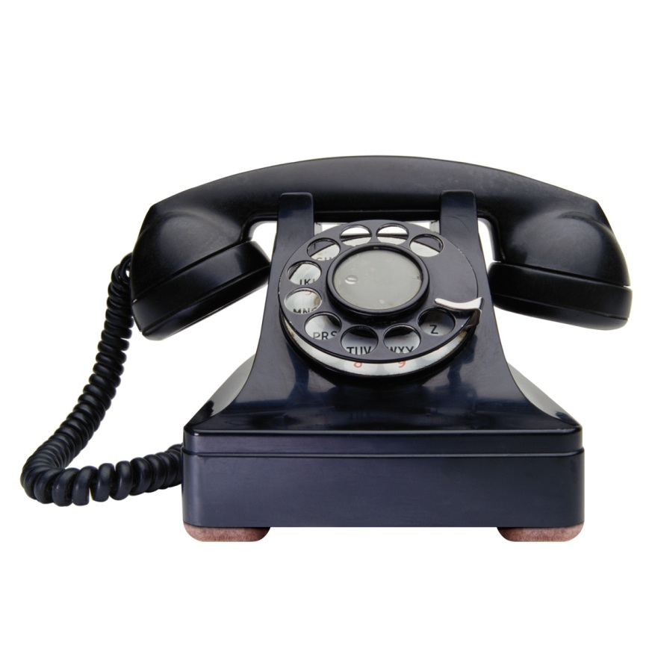
What is this?
It is a telephone.

Slide 10
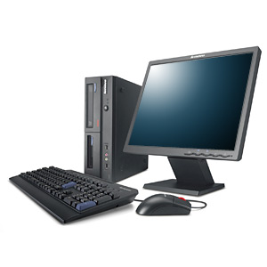
What is this?
It is a computer.

Slide 11
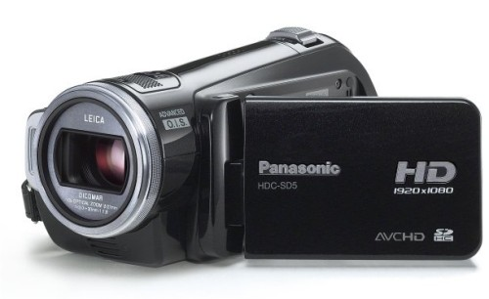
What is this?
It is a camcorder.

Slide 12
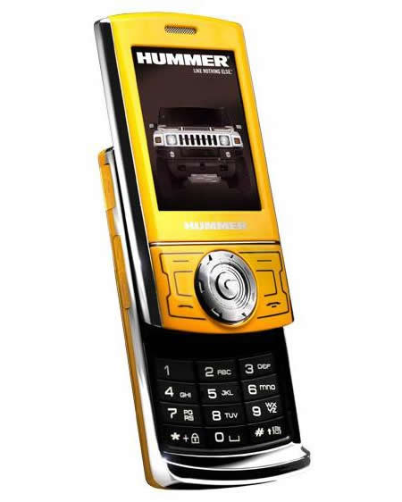
What is this?
It is a cellphone.

